Slide 1
Software Engineering for Machine Learning (AIMLCZG546)
Webinar 1 – ML Systems

Slide 2
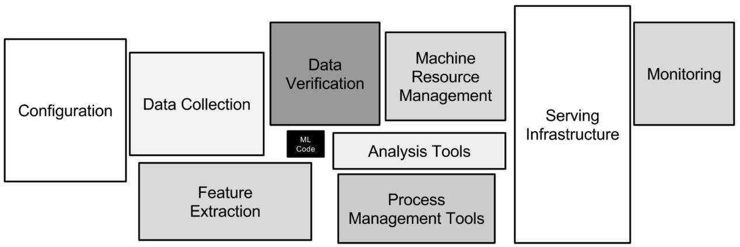
Only a fraction of real-world ML systems is ML code…
ML Code
Sculley, et al. "Hidden technical debt in machine learning systems." NeurIPS 28 (2015): 2503-2511.

Slide 3
Agenda
The ML notebook — what's missing?
Add MLflow · FastAPI · Pydantic · logging live
MLflow UI — compare two runs side by side
Map repo structure onto Sculley diagram
Add /health endpoint
Hook

Slide 4
From notebook to production ML system
The 90% That
Isn't ML Code
This demo starts with a 30-line notebook and grows it into a production-ready
ML service — one layer at a time. Each layer added corresponds to a box in the Sculley "hidden technical debt" diagram
Configuration
Data Collection
Feature Extraction
Process Mgmt
Monitoring
Serving Infra
ML Code
Sculley et al., NeurIPS 2015

Slide 5
The notebook
What's missing?
# step1_notebook.py — 30 lines. It works.
import pandas as pd
from sklearn.ensemble import RandomForestClassifier
import joblib
df = pd.read_csv('data/fraud_data.csv')
X = df[['amount','hour_of_day',
'is_foreign','num_txn_last_hour']]
y = df['is_fraud']
model = RandomForestClassifier(
n_estimators=100, max_depth=5)
model.fit(X_train, y_train)
joblib.dump(model, 'model.pkl')
✕
No schema validation
Bad inputs → silent garbage
✕
No error handling
Crashes at 2am with no trace
✕
No logging
Impossible to debug production
✕
Hardcoded paths
Breaks on any other machine
✕
No model versioning
Which pkl is in production?
✕
No serving
Nobody else can call this model

Slide 6
Required Files for ML System
Step 1 — The notebook (ML model only)
Step 2 — MLflow experiment tracking (model versioning)
Step 3 — FastAPI inference service (serving infrastructure)
Step 4 — Pydantic schema validation (data validation)
Step 5 — Structured logging (monitoring & logging)
Step 6 — Config management (configuration management)
Step 7 — Pytest quality attribute tests (testing)

Slide 7
File structure
fraud_demo/
├── data/generate_data.py ← synthetic dataset
├── training/
│ ├── step1_notebook.py ← Demo 1: the raw notebook (no engineering)
│ └── step2_mlflow_train.py ← Demo 2: +MLflow tracking, run with --trees 200
├── app/
│ ├── config.py ← Step 6: replaces all hardcoded values
│ ├── schemas.py ← Step 4: Pydantic input validation
│ ├── pipeline.py ← pipe-and-filter pattern in Python
│ ├── logger.py ← Step 5: structured JSON logging
│ └── main.py ← Step 3: FastAPI serving
├── tests/test_quality_attrs.py ← Step 7: 15 tests grouped by quality attribute
└── README.md ← Details about the project

Slide 8
4 lines transform experiment tracking
Training logic is IDENTICAL. Only the instrumentation changes.
Before (step 1)
After (step 2)
model = RandomForestClassifier(
n_estimators=100)
model.fit(X_train, y_train)
joblib.dump(model, 'model.pkl')
# ← which version is this?
mlflow.set_experiment('fraud')
with mlflow.start_run():
mlflow.log_params({
'n_estimators': 100})
model.fit(X_train, y_train)
mlflow.log_metrics(metrics)
mlflow.sklearn.log_model(
model, 'fraud_model')
What you gain:
Named experiment bucket
Hyperparameters recorded
Metrics tracked
Model artifact versioned

Slide 9
Serving + validation in code
app/schemas.py — QuestionGoal → input contract
app/main.py — DecisionGoal → endpoint
class TransactionInput(BaseModel):
amount: float = Field(
..., gt=0,
description='Must be positive')
hour_of_day: int = Field(
..., ge=0, le=23)
is_foreign: int = Field(
..., ge=0, le=1)
@app.post('/predict',
response_model=PredictionResult)
def predict_single(
txn: TransactionInput):
with Timer() as t:
result = predict(txn,
store.model)
logger.info('served',
extra={'latency_ms': t.elapsed_ms})
return result
Try in /docs: send amount: -500, hour_of_day: 99 — watch Pydantic reject with field-level errors

Slide 10
Pipe-and-filter
app/pipeline.py
validate_input()
1
2
3
4
extract_features()
run_model()
format_response()
SoftGoal:
Robustness
DataPrep
Task
Prediction
Goal
Insight
→ result
Each stage = pure function · independently testable · swappable without touching other stages
def predict(txn, model):
txn = validate_input(txn) # Stage 1
features = extract_features(txn) # Stage 2
fraud, p = run_model(features, model) # Stage 3
return format_response(fraud, p) # Stage 4

Slide 11
Pipe-and-filter
Pipe | Carries | Python type | From → To
Pipe 1 | Validated transaction | TransactionInput | Filter 1 → Filter 2
Pipe 2 | Numeric feature array | np.ndarray (1, 4) | Filter 2 → Filter 3
Pipe 3 | Prediction + probability | (bool, float) | Filter 3 → Filter 4
Pipe 4 | Structured API response | PredictionResult | Filter 4 → HTTP caller

Slide 12
Pipe-and-filter
 | Function | Responsibility | Quality attribute
1 | validate_input() | Business-rule checks on raw input | Robustness
2 | extract_features() | Encode + order model inputs | Maintainability
3 | run_model() | Run RandomForest, return probability | Performance
4 | format_response() | Apply risk tiers, build API schema | Reliability

Slide 13
pytest tests grouped by quality attribute
QA: Robustness
QA: Reliability
class TestRobustness:
class TestReliability:
# schema rejects amount=-500
# all outputs are well-formed
QA: Performance
QA: Maintainability
class TestPerformance:
class TestMaintainability:
# latency < 200ms
# each pipeline stage isolated
pytest tests/ -v → 15 passed in approx. 2.6s

Slide 14
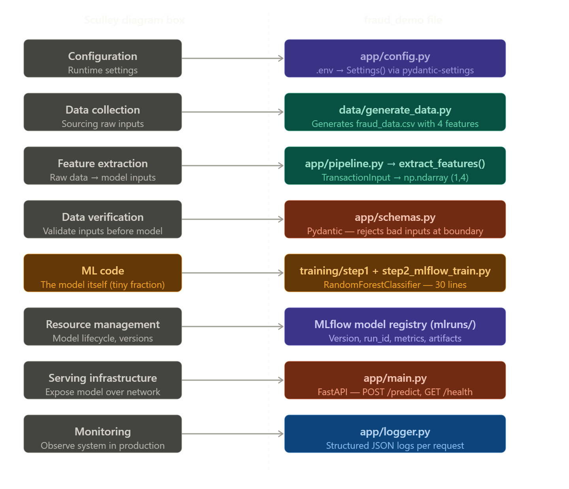
Adding production layers
The Sculley diagram → actual files

Slide 15
GITHUB ACTIONS

Slide 16
What is a CI tool
A CI tool is a platform that automates the process of building, testing, and publishing your software.
CI tools integrate with version control system so they can fetch the latest changes from your repository.
Most CI tools consist of a central server (often known as a build server) and one or more build agents (or runners) that run on separate machines.
The build server provides a UI for configuring your build and test pipelines, stores the details of each job, and initiates each pipeline run.
The build, test, and other tasks are distributed to the build agents by the build server. If multiple build agents are available, multiple pipelines can run at the same time, and tasks from the same pipeline can be run in parallel.
https://blog.jetbrains.com/teamcity/2023/07/best-ci-tools/

Slide 17
GitHub Actions
GitHub’s native CI/CD and automation system
GitHub Actions was introduced by GitHub in 2018.
It is integrated right into GitHub and enabled by default in every GitHub repository.

Slide 18
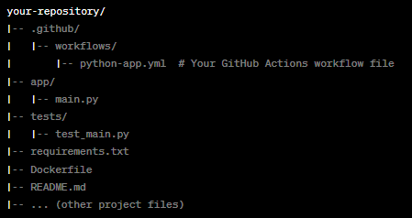
Typical GitHub Actions – Workflow structure

Slide 19
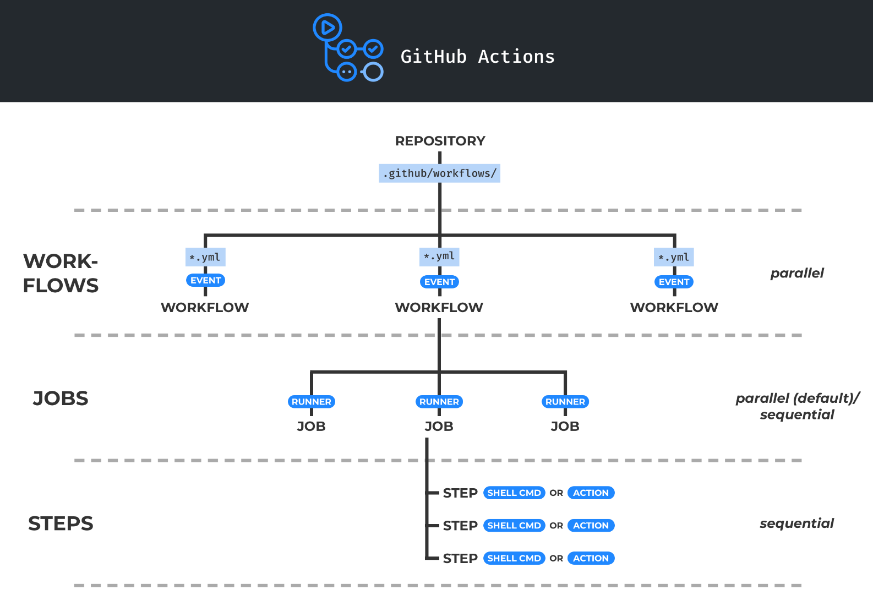
GitHub Actions
A workflow is triggered by one or more events. Event can be internal (push or PR) or external (webhook call)
A job contains a set of commands that will be run when the workflow is triggered
A runner is a virtual machine hosted by GitHub with an operating system. Each job runs inside a container
A step is either a shell command or an action
An action is a reusable unit of code which can be included as a step of a job. Actions can have inputs and outputs.

Slide 20
Continuous Integration Best Practices
Maintain a code repository
Automate the build
Make the build self-testing
Everyone commits to the baseline every day
Every commit (to baseline) should be built
Keep the build fast
Test in a clone of the production environment
Make it easy to get the latest deliverables
Everyone can see the results of the latest build
Automate deployment

Slide 21
Continuous Integration Practices
1. Maintain a code repository
This practice advocates the use of a revision control system for the project's source code. All artifacts required to build the project should be placed in the repository. In this practice and the revision control community, the convention is that the system should be buildable from a fresh checkout and not require additional dependencies. It is preferred for changes to be integrated rather than for multiple versions of the software to be maintained simultaneously. The mainline should be the place for the working version of the software.
2. Automate the build
A single command should have the capability of building the system (Ex: “pyb”). Many build tools, have existed for many years. Other more recent tools are frequently used in continuous integration environments. Automation of the build should include automating the integration, which often includes deployment into a production-like environment. In many cases, the build script not only compiles binaries but also generates documentation, website pages, statistics and distribution media

Slide 22
Continuous Integration Practices
3. Make the build self-testing
Once the code is built, all tests should run to confirm that it behaves as the developers expect it to behave.
4. Everyone commits to the baseline every day
By committing regularly, every committer can reduce the number of conflicting changes. Checking in a week's worth of work runs the risk of conflicting with other features and can be very difficult to resolve. Early, small conflicts in an area of the system cause team members to communicate about the change they are making. Committing all changes at least once a day is generally considered part of the definition of Continuous Integration. In addition, performing a nightly build is generally recommended. These are lower bounds; the typical frequency is expected to be much higher.

Slide 23
Continuous Integration Practices
5. Every commit (to baseline) should be built
The system should build commits to the current working version to verify that they integrate correctly. A common practice is to use Automated Continuous Integration, although this may be done manually. Automated Continuous Integration employs a continuous integration server or daemon to monitor the revision control system for changes, then automatically run the build process.
6. Every bug-fix commit should come with a test case
When fixing a bug, it is a good practice to push a test case that reproduces the bug. This avoids the fix to be reverted, and the bug to reappear, which is known as a regression.
7. Keep the build fast
The build needs to complete rapidly so that if there is a problem with integration, it is quickly identified.

Slide 24
Continuous Integration Practices
8. Test in a clone of the production environment
Having a test environment can lead to failures in tested systems when they deploy in the production environment because the production environment may differ from the test environment in a significant way. However, building a replica of a production environment is cost-prohibitive. Instead, the test environment or a separate pre-production environment ("staging") should be built to be a scalable version of the production environment to alleviate costs while maintaining technology stack composition and nuances.

Slide 25
Continuous Integration Practices
9. Everyone can see the results of the latest build
It should be easy to find out whether the build breaks and, if so, who made the relevant change and what that change was.
10. Automate deployment (CD)
Most CI systems allow the running of scripts after a build finishes. In most situations, it is possible to write a script to deploy the application to a live test server that everyone can look at. A further advance in this way of thinking is continuous deployment, which calls for the software to be deployed directly into production, often with additional automation to prevent defects or regressions.

